Slide 1
Team 2 ParkEz
UML Class and Sequence Diagrams for Iteration 4

Slide 2
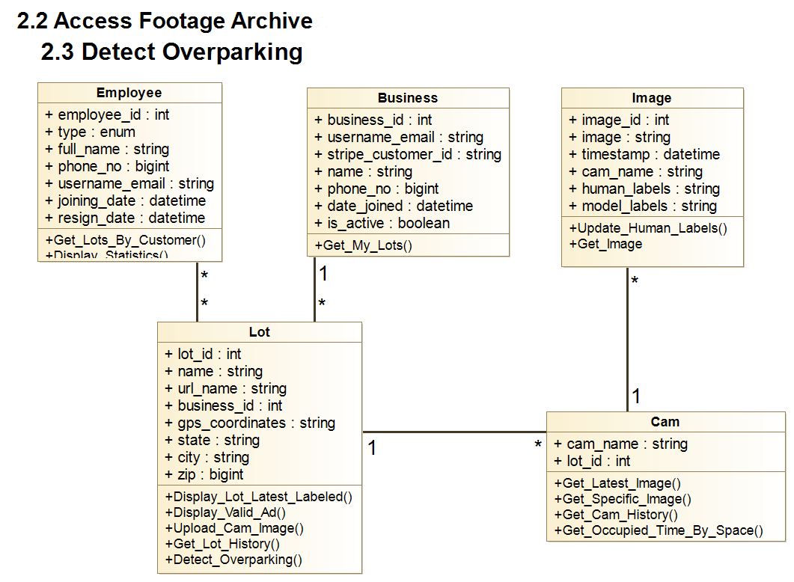

Slide 3

Normal Flow of Events:
1. The actors initiate the use case by navigating to the business website, where ParkEz parking information is seamlessly embedded. 2. Upon reaching the website, the actors access and review the current occupancy information. This includes detailed insights into the number of occupied and vacant parking spots over a specified period.
3. Subsequently, the actors explore webcam images available on the website, providing a visual representation of the actual parking lot. These images feature indicators highlighting the status of occupied and vacant spots for the designated time frame.
4. The system responds by presenting overparking confirmations, complete with car images captured at half-hour intervals during the specified period. This information is dynamically generated based on the usage of parking time.
5. Armed with a comprehensive understanding of the parking and overparking scenarios, the actors leverage the provided information to make informed decisions regarding their parking strategy or addressing any overparking incidents that may have occurred during the specified period.
2.2 Access Footage Archive
:Lot Business User Lot Business Manager
Customer Support Manager
:Lot
:Cam
:Image
Get_Lot_History
Get_Cam_History
Get_Image
Lot Overview
Image and Labels
Image and Labels

Slide 4
2.2 Access Footage Archive
:Lot Business User Lot Business Manager
Customer Support Manager
:Lot
:Cam
:Image
A1. “Parking Lot is Full”:
1. If, upon reaching step 2, the system detects that the parking lot is at full capacity, it refrains from providing a best spot recommendation. The system explicitly communicates that there is no available spot through the best spot recommendation, which is indicated as "None."
Get_Lot_History
Get_Cam_History
Get_Image
Lot Overview*
Image and Labels
Image and Labels
*Includes information indicating Parking Lot is full

Slide 5
2.2 Access Footage Archive
:Lot Business User Lot Business Manager
Customer Support Manager
:Lot
:Cam
:Image
E1. “Webcam or Transmitter Down”:
1. In the event of a webcam service or image transmitter outage, the system gracefully handles the situation by displaying the last available image along with the corresponding parking lot information. This ensures that the actors still have access to the most recent data despite the temporary disruption.
2. If the webcam service or image transmitter is down, the system takes a proactive approach by refraining from saving any data in the archive for overparking confirmation footage. This precautionary measure prevents the storage of potentially incomplete or inaccurate information during the downtime, maintaining the integrity of the parking system records.
Get_Lot_History
Get_Cam_History
Get_Image
Lot Overview*
Image and Labels
Image and Labels
*Frontend notes possible error and lang in receiving image

Slide 6
2.3 Detect Overparking
:Lot Business User Lot Business Manager
Customer Support Manager
:Lot
:Cam
:Image
Get Occupied_Time By_Space
Normal Flow of Events
1. The use case begins when the Actor logs into the system and navigates to 'Parking Monitoring'.
2. The System processes incoming images and identifies occupied parking spots.
3. The System calculates the duration each vehicle has been parked.
4. The System flags vehicles that exceed the parking time limit.
5. The System sends a notification to the Actor about the overparking incident.
6. The Actor reviews the overparking details.
7. The Actor takes necessary action, such as notifying enforcement.
8. The Actor receives alerts for any data inconsistencies or processing errors and resolves them.
9. This use case ends when the Actor logs out or navigates away from the 'Parking Monitoring' screen.
Detect_Overparking
Get_Image
Each Space and Time Occupied
Overparking by Spot
Image and Labels

Slide 7
2.3 Detect Overparking
:Lot Business User Lot Business Manager
Customer Support Manager
:Lot
:Cam
:Image
Get Occupied_Time By_Space
E1. “System Failure” 1. The System logs the error and alerts the Customer Support Manager.
2. The Customer Support Manager investigates and resolves the issue..
Detect_Overparking
Get_Image
Error Message
Error Message
Error Message

